Slide 1





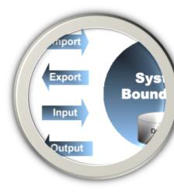
By: Võ Văn Hải
Email: vovanhai@iuh.edu.vn
Spring Security
1
30/11/2023
1

Slide 2
Spring Security
Introduction
▸Spring Security is a framework that focuses on providing both authentication and authorization (access control) to java web application and SOAP/REST web services.
▸Spring framework supports integration with many technologies
HTTP basic authentication
LDAP
OpenID providers
JAAS API
- …
And customized authentication system (by yourself)
30/11/2023
2
2

Slide 3
Spring Security
Terminologies
▸Principal
▸User that performs the action
▸Authentication
▸Confirming truth of credentials
▸Authorization
▸Define access policy for principal
▸GrantedAuthority
▸Application permission granted to a principal
▸SecurityContext
▸AuthenticationManager
▸Controller in the authentication process
▸AuthenticationProvider
▸Interface that maps to a data store which stores your user data.
▸Authentication Object
▸Object is created upon authentication, which holds the login credentials.
▸UserDetails
▸Data object which contains the user
credentials, but also the Roles of the user.
▸UserDetailsService
▸Hold the authentication security information
▸SecurityContextHolder
and other
- Collects the
user credentials,
▸Provides access to SecurityContext
authorities(roles) and build an UserDetails object.
30/11/2023
3
3

Slide 4
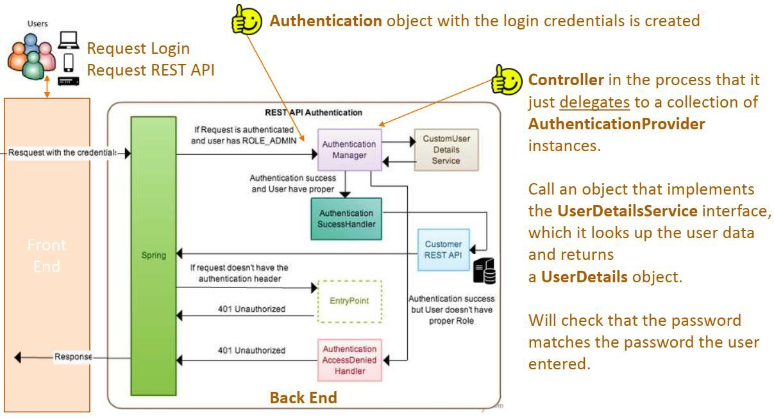
Spring Security
Architecture
30/11/2023
5
5

Slide 5
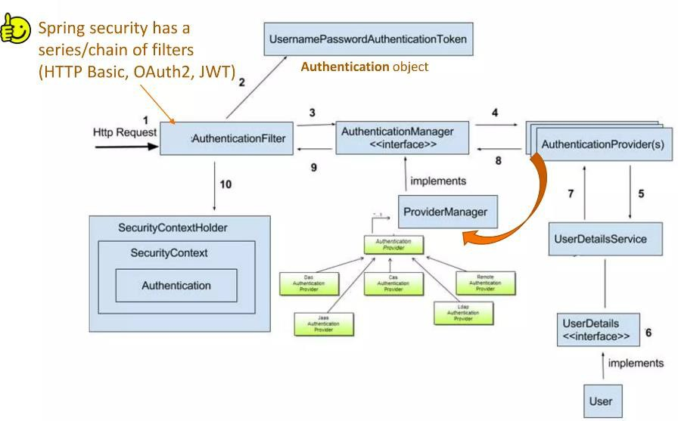
Spring Security
flow
30/11/2023
6
6

Slide 6
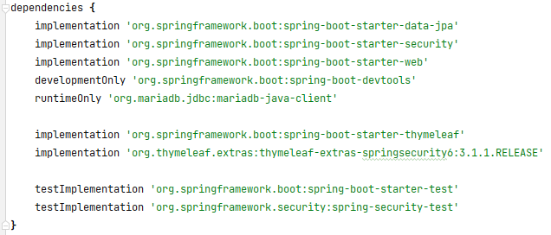
Spring Security
Practice
▸In Spring 6.x, by adding the dependency to project, when you access any
resources, you should provide the credential.
▸To manage the resources grant/deny permission, you should configure them using XML or by code.
▸There are many way to implements the security in Spring.
30/11/2023
7
7

Slide 7
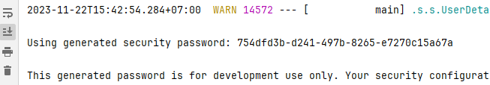

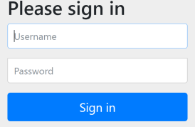
Spring Security
Practice (cont.)
▸Default username: user
▸Default password: the password generate when we run the application
▸We can change the default password by specify in application.properties
http://bcrypt-generator.com
default logon form
30/11/2023
8
8

Slide 8
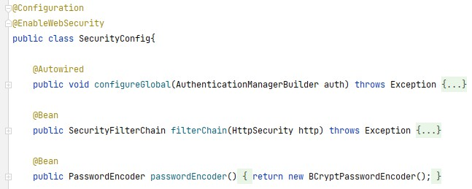
Spring Security
Configuration
▸Sample steps:
Create any class with the @Configuration annotation.
Add @EnableWebSecurity
Create a method with a parameter with type AuthenticationManagerBuilder
Create a bean with return type SecurityFilterChain and a parameter with type HttpSecurity
30/11/2023
9
9

Slide 9
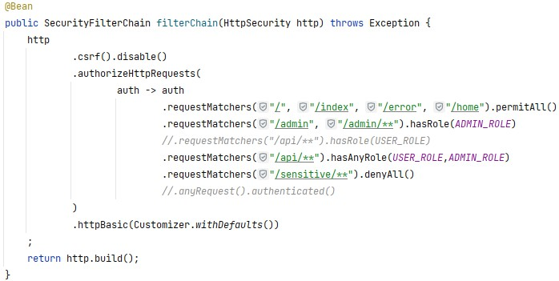
Spring Security
Resources' grant/deny permission
▸You should specify resources for protecting.
- PermitAll()
Authenticated()
denyAll()
hasAnyRole()
** Instead of grant/deny access for each credential, you should grant/deny access for a role.
- hasRole()
- …
30/11/2023
10
10

Slide 10
Spring Security
Providing credentials
▸You can provide credential by many ways:
In memory
Using JDBC
Using OAuth2AuthorizeRequest
Using LDAP
- …
▸In this study, in memory and using JDBC credentials are used.
30/11/2023
11
11

Slide 11
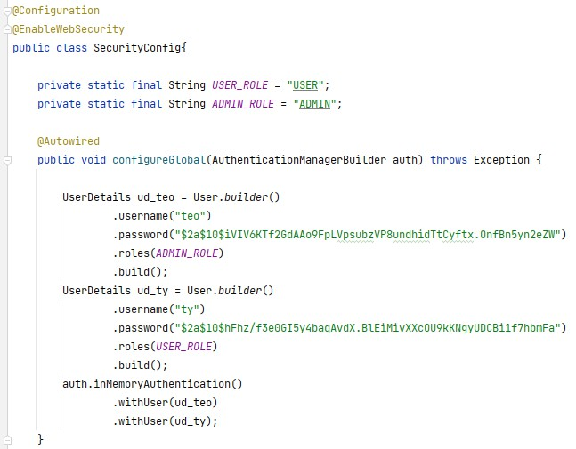
Credentials
In-memory credential
Provide role for users
Using
BCryptPasswordEncoder for encoding the password
30/11/2023
12
12

Slide 12
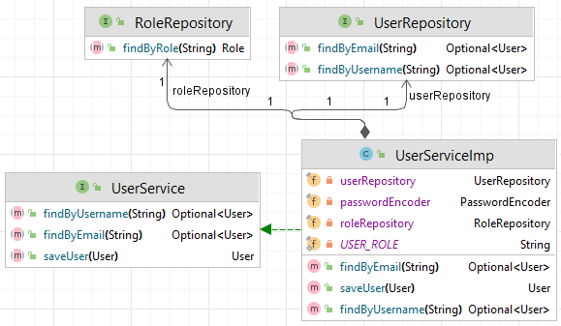
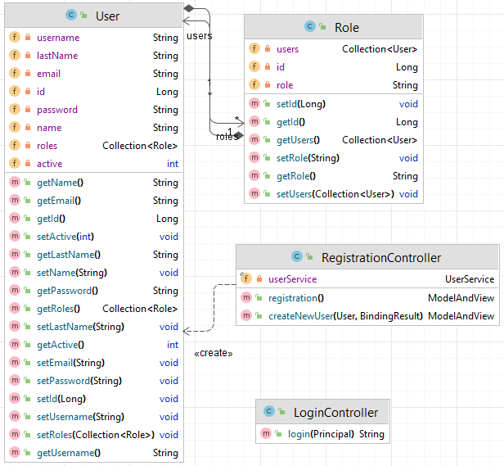
Credentials
Using JDBC credentials (1)
30/11/2023
13
13

Slide 13
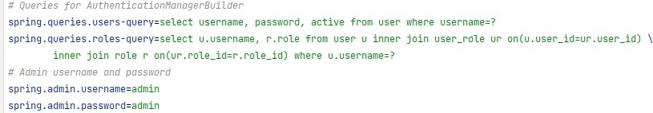
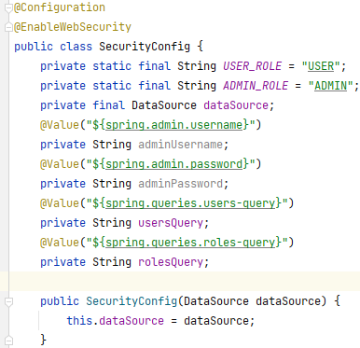
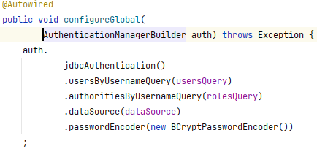

Credentials
Using JDBC credentials (2)
30/11/2023
14
14

Slide 14
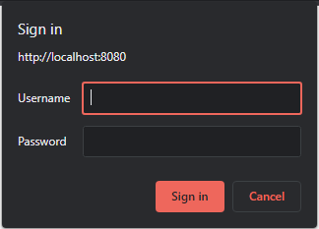
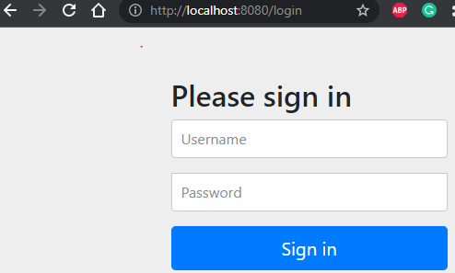
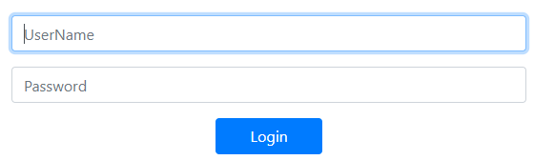
Logon Forms
Security form
▸The logging forms:
From web browser (system)
From spring security
Custom (specify the logon form by yourself)
30/11/2023
15
15

Slide 15
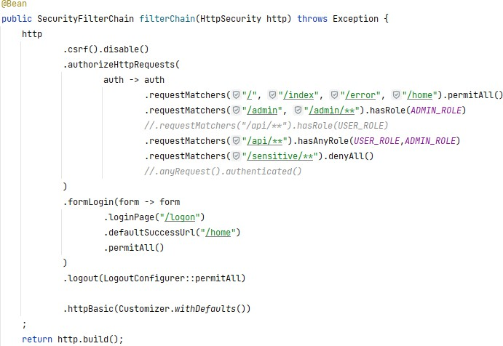
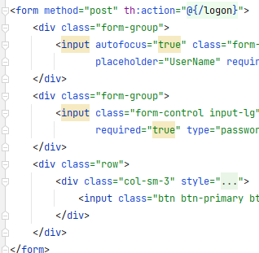
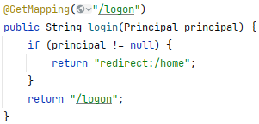
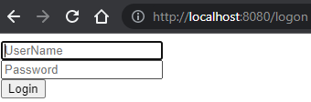
Logon Forms
Custom logon form
30/11/2023
16
16

Slide 16

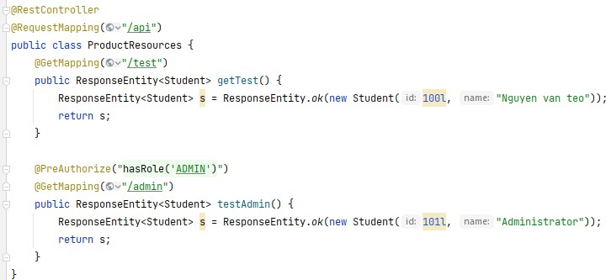
Method level security
Method’s Security
▸In case of specifying roles for accessing methods, you should enable
method security.
▸Using @EnableMethodSecurity annotation an any @Configuration class
30/11/2023
17
17

Slide 17
Spring Security
Other techniques
▸OAuth2 (Single sign-On)
▸JSON Web Token (JWT)
▸OpenID Connect
▸…
30/11/2023
18
18

Slide 18
Cross-Site Request Forgery (CSRF)
Introduction
▸Cross-Site Request Forgery (CSRF) is an attack that forces an end user to execute unwanted actions on a web application in which they’re currently authenticated.
▸With a little help of social engineering (such as sending a link via email or chat), an attacker may trick the users of a web application into executing actions of the attacker’s choosing.
▸If the victim is a normal user, a successful CSRF attack can force the user to perform state changing requests like transferring funds, changing their email address, and so forth.
▸If the victim is an administrative account, CSRF can compromise the entire web application.
▸There are multiple forms of CSRF attack. Two simple CSRF attacks that most common happen:
Using GET method
Using POST method
30/11/2023
19
19

Slide 19
CSRF attacks
Using get method
▸Let’s consider the following GET request used by a logged-in user to transfer money to a specific bank account 1234
GET http://bank.com/transfer?accountNo=1234&amount=100
▸If the attacker wants to transfer money from a victim’s account to his own account instead — 5678 — he needs to make the victim trigger the request:
GET http://bank.com/transfer?accountNo=5678&amount=1000
▸There are multiple ways to make that happen:
- Link – The attacker can convince the victim to click on this link, for example, to
execute the transfer:
<a href="http://bank.com/transfer?accountNo=5678&amount=1000"> Show Kittens Pictures
</a>
- Image – The attacker may use an <img/> tag with the target URL as the image source. In other words, the click isn’t even necessary. The request will be automatically executed when the page loads:
<img src="http://bank.com/transfer?accountNo=5678&amount=1000"/>
30/11/2023
20
20

Slide 20
CSRF attacks
Using POST method
▸Suppose the main request needs to be a POST request:
POST http://bank.com/transfer accountNo=1234&amount=100
▸In this case, the attacker needs to have the victim run a similar request:
POST http://bank.com/transfer accountNo=5678&amount=1000
▸Neither the <a> nor the <img/> tags will work in this case.
▸The attacker will need a <form>:
The form can be submitted automatically using JavaScript:
<form action="http://bank.com/transfer" method="POST">
<input type="hidden" name="accountNo" value="5678"/>
<input type="hidden" name="amount" value="1000"/>
<input type="submit" value="Show Kittens Pictures"/>
</form>
<body onload="document.forms[0].submit()">
<form>
...
</form>
30/11/2023
21
21

Slide 21
Spring MVC web with CSRF
Prevent CRSF attack
▸To protect MVC applications, Spring adds a CSRF token to each generated view.
▸This token must be submitted to the server on every HTTP request that
modifies state (PATCH, POST, PUT and DELETE — not GET).
▸This protects our application against CSRF attacks since an attacker can’t
get this token from their own page.
▸Starting from Spring Security 4.x, the CSRF protection is enabled by default.
▸This default configuration adds the CSRF token to the HttpServletRequest attribute named _csrf.
@Bean
public SecurityFilterChain filterChain(HttpSecurity http) throws Exception { http
.csrf().disable();
return http.build();
}
If we need to, we can disable this configuration but not recommended
30/11/2023
22
22

Slide 22
Spring MVC web with CSRF
Client prevent CSRF attack configuration
▸We need to include the CSRF token in our requests. The _csrf attribute
contains the following information:
token – the CSRF token value
parameterName – name of the HTML form parameter, which must include the token value
headerName – name of the HTTP header, which must include the token value
▸In case of using HTML forms, the headerName and token values should be added HTTP header.
<input type="hidden" name="${_csrf.parameterName}" value="${_csrf.token}"/>
▸In case of using JSON view forms, the headerName and token values should be added HTTP header.
//1. include the token value and the header name in meta tags
<meta name="_csrf" content="${_csrf.token}"/>
<meta name="_csrf_header" content="${_csrf.headerName}"/
// 3. Finally, let’s use these values to set our XHR header:
$(document).ajaxSend(function (e, xhr, options) { xhr.setRequestHeader(header, token);
});
//2. Then let’s retrieve the meta tag values with JQuery:
var token = $("meta[name='_csrf']").attr("content");
var header = $("meta[name='_csrf_header']").attr("content");
30/11/2023
23
23

Slide 23

Session with Jdbc
24
30/11/2023
24

Slide 24
Session with Jdbc
30/11/2023
25
25

Slide 25
Session with Jdbc
Configuring Concurrent Session Control
▸ To prevent a user from logging in multiple times - a second login will cause the first to be invalidated.
@Bean
public SecurityFilterChain filterChain_Session(HttpSecurity http) throws Exception { http.sessionManagement()
;
return http.build();
}
.maximumSessions(1)
▸In case of preventing a second login, you can use
//to prevent a second login
.maxSessionsPreventsLogin(true)
▸The second login will then be rejected. By "rejected", we mean that the user will be sent to the authentication-failure-url if form-based login is being used. If the second authentication takes place through another non-interactive mechanism, such as "remember-me", an "unauthorized" (401) error will be sent to the client. If instead you want to use an error page, you can add the attribute session- authentication-error-url to the session-management element.
30/11/2023
26
26

